Slide 1
Making of Byzantine Fault Tolerant Systems Presented by:- Sphoorti Poojary Shishir Kulkarni Shubham Pachpute Under the guidance of: Prof. Tanuja Phadke

Slide 2
Background:
Fault: A fault is defined as an abnormal condition or defect at the component, equipment, or sub-system level which may lead to a failure.
In fault-tolerant computer systems, and in particular distributed computing systems, Byzantine fault tolerance (BFT) is the characteristic of a system that tolerates the class of failures known as the Byzantine Generals' Problem.
Characterized By: 'roll-forward’ OR 'roll-back’.

Slide 3
Some definitions:
Synchronous Interval: During a synchronous interval any message sent between correct processes s delivered within a bounded delay T if the sender retransmits according to some schedule until it is delivered.
Gracious Execution: An execution is gracious iff (a) the execution is synchronous with some implementation-dependent short bound on message delay and (b) all clients and servers behave correctly.
Notes:
RBFT explicitly considers performance during both
gracious intervals—when the network is synchronous,
replicas are timely and fault-free, and clients correct—
and uncivil execution intervals in which network links
and correct servers are timely, but up to f = n−1
3  servers and any number of clients are faulty.

Slide 4
Some definitions:
Uncivil Execution: An execution is uncivil iff (a) the execution is synchronous with some implementation-dependent short bound on message delay, (b) up to f servers and an arbitrary number of clients are Byzantine, and (c) all remaining clients and servers are correct.
The engineering of BFT protocols has embraced Lampson’s well-known recommendation: “Handle normal and worst case separately as a rule because the requirements for the two are quite different. The normal case must be fast. The worst case must make some progress”.
Notes:
In our view, a BFT system fulfills its obligations
when it provides acceptable and dependable performance
across the broadest possible set of executions, including
executions with Byzantine clients and servers.

Slide 5
Proposal:
Build RBFT systems(Aardvark) that provide adequate performance during uncivil executions.
This approach is likely to reduce the best case performance, but for a BFT system a limited reduction in peak throughput is preferable than to have a Loss of availability.
Aardvark prototype reaches a peak throughput of 38667 req/s compared to PDFT which is approximately 61710 req/s but for gracious exceutions.

Slide 6
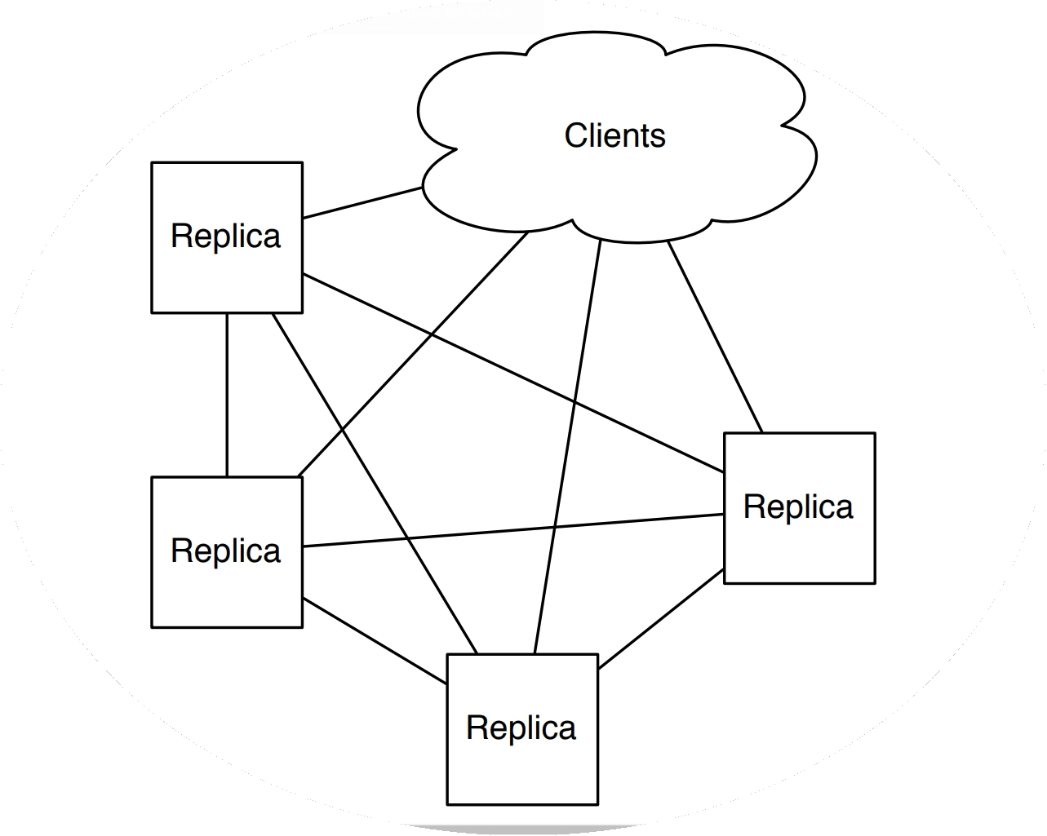
Aardvark - RBFT in action
Has the same semantic structure of previous implementations but revised implementations to achieve robustness, ease of implementation and acceptable performance.
3 stage protocol: Client request transmission, Replica agreement and view change.
3 main design differences: Signed client requests, resource isolation and regular view changes.

Slide 7
Signed client requests
Uses signed messages which provide non-repudiation. Establishes the authenticity of the client. Better than the weaker MAC based authentication. Eliminates the necessity of extra handling required with MAC.
Signatures are costly. Possible reduction in performance. Hence, the messages are signed by the client and only the verification part is handled by the primary and replicas. Verification part is not as costly as compared to signature themselves.
But verification of the signatures is also costly. Vulnerable to DOS attacks. Two possible solutions: 1) Hard limit on the number of faulty requests that a client can make. 2) Synchronize client requests so that newer requests cannot be placed before older ones complete.
Signed requests are used only for communication between client and systems. The replica to replica, primary to replica communication still uses the old MAC based authentication. Quorum-driven nature of server initiated communication ensures agreement.

Slide 8
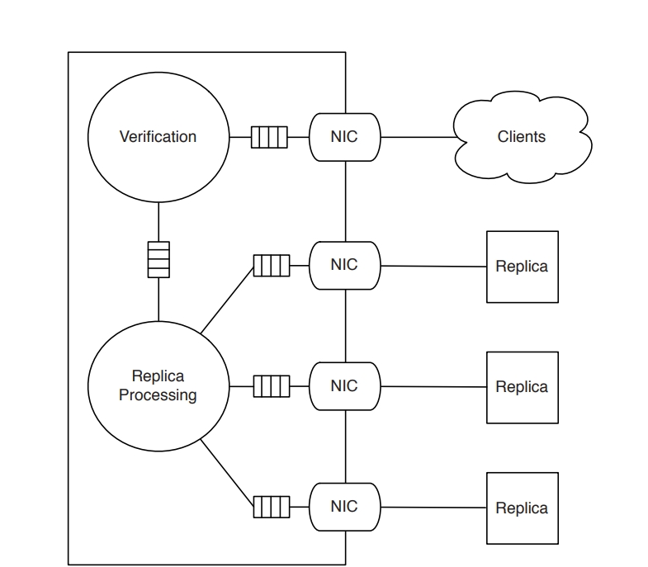
Resource isolation
Separate network interfaces between the replicas. This prevents brute force denial of service attacks and prevents any faulty server from interfering with timely delivery of messages.
Performance hit for multicast. Since no efficient way of all-to-all communication.
Separate network queue for clients and replicas. This isolates the replica to replica communication ensuring progress criteria of the protocol.
Can take advantage of hardware parallelism by employing different threads to process different messages.

Slide 9
Regular view changes
A view change operation is invoked on a regular basis.
Replicas monitor the throughput of the current primary and raise the threshold by a small amount gradually. If the current primary is unable to support that throughput, a view change is invoked.
This technique tackles throughput degradation caused by a faulty primary. Because it either forces a primary to be fast or elect a new primary.
There is a tradeoff however. Previous implementations used view change as a last resort since it is expensive. But this tradeoff is acceptable because consequences of a misbehaving primary can far more devastating.

Slide 10
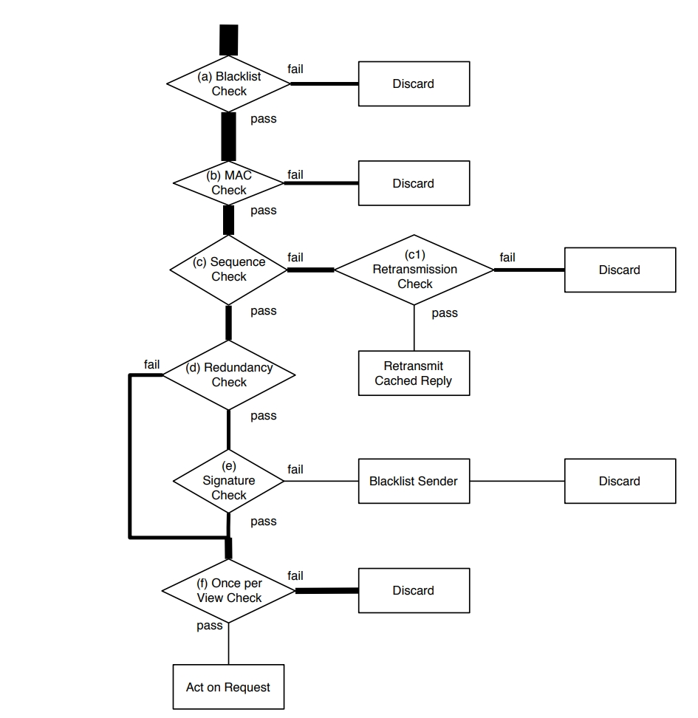
Client Message transmission
Client sends a message to a replica which it thinks is primary. Each message has a client sequence number and a signature.
To prevent DOS, the flowchart shows steps of gradually increasing complexity. Any anomalies are discarded in earlier steps to avoid expensive operations being performed on every message.

Slide 11
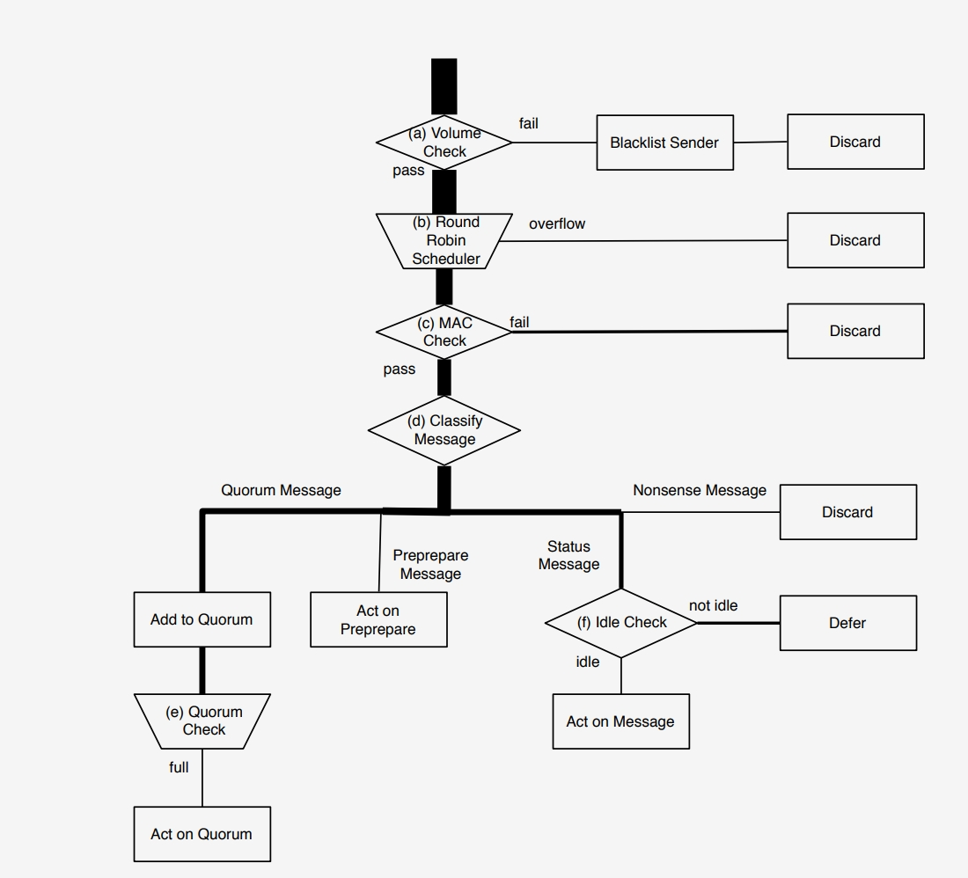
3-Phase commit agreement protocol
Communication between the replicas.
Main challenge is ensuring that each replica can collect the quorums of PREPARE and COMMIT messages necessary to make progress
Ensures robustness in two ways:
1) incorrect messages from faulty replicas never gain the support of a quorum of replicas.
2) As long as there exists a quorum of correct replicas, a faulty replica cannot impede progress.

Slide 12
Analysis
Analyze throughput characteristics of Aardvark
No of client requests large enough to saturate system and fraction ‘g’ of the requests are correct

Slide 13

In a gracious view when system is saturated and all requests come from correct client throughput is t_{peak}
In an uncivil view, when primary replica is correct, f replicas are Byzantine and fraction g of requests are correct throughput is g x t_{peak}
For long uncivil executions and small f throughput is x g x t_{peak}

Slide 14
Evaluation of performance of Aardvark, PBFT, HQ, Q/U and Zyzzyva
Despite choice to utilize signatures, change views regularly, and forsake IP multicast
Aardvark’s peak throughput is competitive with that of existing systems
Existing systems are vulnerable to significant disruption as a result of a broad range of Byzantine behaviours.
Aardvark is robust to a wide range of Byzantine behaviours.

Slide 15
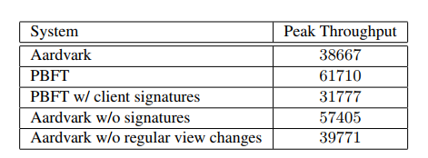
Peak throughput comparison of Aardvark and PBFT

Slide 16
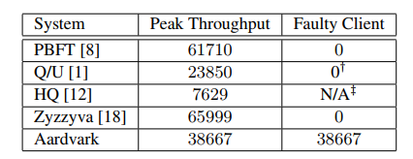
Throughput in presence of failures
Faulty clients

Slide 17
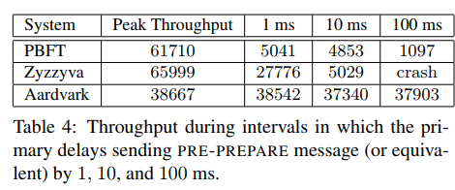
Faulty primary

Slide 18
Conclusion
The authors present Aardvark the first BFT state machine protocol which provides good performance during Byzantine faults
Gives up some throughput during gracious executions to provide significant improvements during uncivil executions

Slide 19
Reference
Allen Clement, Edmund Wong, Lorenzo Alvisi, Mike Dahlin, Mirco Marchetti, “Making Byzantine Fault Tolerant Systems Tolerate Byzantine Faults”, NSDI ’09: 6th USENIX Symposium on Networked Systems Design and Implementation

Slide 20
Thank You!

